Slide 1
Advance Queries in MongoDB

Slide 2
CRUD Operations
CRUD stands for Create – Read – Update – Delete, the four basics operations on data of any database system
I will compare to SQL statements for them. Detail explanations come in next slides
Operation | RDBMS SQL Statement | MongoDB Equivalent
Create | CREATE TABLE test (id INT, name VARCHAR(20)); | db.createCollection(“test”)
Create | INSERT INTO test VALUES (1,”test 1”); | db.test.insert({“id”:1,”name”:”test 1”})
Read | SELECT * FROM test; | db.test.find()
Read | SELECT * FROM test WHERE id=1; | db.test.find({“id”:1})
Update | UPDATE test SET name = “test 2” WHERE id=1; | db.test.update({“id”:"1234534”}, {$set: {“name":”test 2”}} , {multi: true});
Delete | DELETE FROM test WHERE id=1; | db.test.drop({“id”:1})

Slide 3
Insert Data
Insert one document:
db.<collection>.insertOne({["<field>":<value>]})
<field> is the name of the field
<value> is the value of the field, string values must be inside quotes
Can have multiple <field>:<value> separated by commas ,
Example
db.people.insertOne(
{"PID":"000101", "first_name":"Alice", "last_name":"Smith", "age": 30}
)

Slide 4
Insert Many Document Simultaneously
For inserting multiple documents, we use insertMany()
db.<collection>.insertMany([{["<field>":<value>]}])
Similar to insertOne(), however can have multiple documents separated by commas ,
All documents are placed in a single [ ], similar to a Python list
Example
db.people.insertMany([
{"PID":"000234","first_name":"Carol","last_name":"Brown", "age": 25},
{"PID":"000236","first_name":"Daniel","last_name":"Davis", "age": 35}
])

Slide 5
Query data
General syntax: db.<collection>.find({<field>:<criteria>})
Examples:
Get everything: db.people.find()
Find people with age = 36: db.people.find({"age": 36})
Find people with first name similar to “Emm”: db.people.find("first_name": /Emm/)
For comparison, the criteria has the form {<operator>: <value>}
Operators: $eq (=), $gt (>), $gte (>=), $lt (<), $lte (<=)
Examples:
Find people older than 30: db.people.find({"age": {$gte:30}})

Slide 6
More Complicated Queries
Multiple <field>: <criteria> can be put into a single find() to combine conditions with the AND operator.
The search criteria must be in the same {}
Example: find people whose first name has “Emm” and older than 23
db.people.find({"first_name": /Emm/, "age": {$gt:23}})
Select fields to show in result:
We add a second argument to find().
db.<collection>.find(
{<field>:<criteria>},
{<field_to_show>:1, <field_to_hide>:0}
)
Find people whose first name has “Emm” and only show their first and last name
db.people.find({"first_name":/Emm/}, {"first_name":1, "last_name":1, _id:0})

Slide 7
Update
Use the updateMany() or function. Since we need to find before update, the first argument is similar to find()
db.<collection>.updateMany(
{<field>:<criteria>},
{$set:{<field>:<new_value>}}
)
New fields can be added directly in the $set operator
Examples:
db.people.updateMany({"PID":"000101"},{$set:{"last_name":"Jones","age":35,"email":"alice@mail.com"}})
To remove an existing field, use $unset:
{$unset: {<field_to_remove>:""}}
Example:
db.people.updateMany({"PID":"1234534"}, {$unset: {"phone_number":""}} , {multi: true})

Slide 8
Delete data
Use the deleteOne() or deleteMany() function
db.<collection>.deleteOne({<field>: <criteria>})
Example
db.people.deleteOne({"PID":"1234534"})

Slide 9
Aggregating Queries
We use aggregate() function for summary queries like sum, average, min, max, etc.
Basic usage is as below:
db.<collection>.aggregate([
{$group:{_id: null,
“<summary name>”: {<operator>:"$<field>"}}}
])
_id : null if no grouping
<summary name> is what you want to call the summary value
<operator> is the summarizing operator, $sum, $avg, $min, $max, etc.
<field> is the data field you want the summarization. The $ is mandatory syntax
Example, the equivalent to SELECT SUM(quantity) FROM items; db.items.aggregate([
{$group: { _id: null, "total_quantity": {$sum:"$quantity"}}}
])

Slide 10
Aggregation with search criteria
To have an equivalent of the SQL WHERE statement, add a $match operator, which is similar to input of find()
db.items.aggregate([
{$match: {"quantity":{$gte:10}}},
{$group: { _id: null, "average_cost": {$avg:"$price"}}}
])

Slide 11
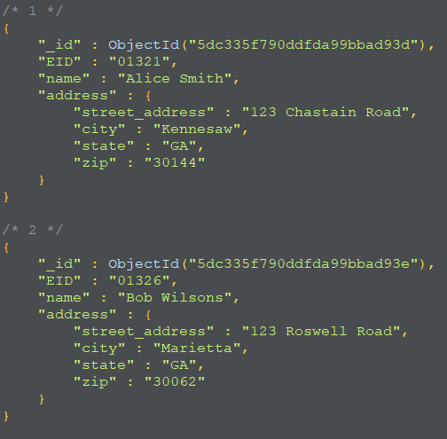
Embedded Documents
A field in a document may contain an embedded document
As in the example, the value of the field is another document
Usually used when we have a one-to-one or one-to-many relationship
To insert, we still use insertOne() or insertMany(), example:
db.employees.insertMany({
"EID":"01321",
"name":"Alice Smith",
"address": {
"street_address":"123 Chastain Road",
"city":"Kennesaw",
"state":"GA",
"zip":"30144"}
})

Slide 12
Query with Fields in Embedded Documents
We still use find() like normal
Fields in embedded documents can be accessed with <main_field>.<embedded_field>
<main_field>: the field in the main document
<embedded_field>: the field in the embedded document
For example, find employee whose zip in address is 30144
db.employees.find({"address.zip":"30144"})

Slide 13
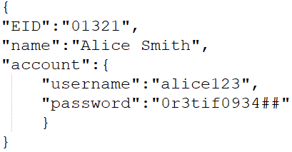
Relationships in MongoDB
MongoDB is not a relational database and therefore does not have direct implementations of entity relationships
Instead, we can use a combination of embedded documents and lists
If you have a one-to-one relationship between data entities, it is better to transform one into embedded documents
For example, if one person has one account

Slide 14
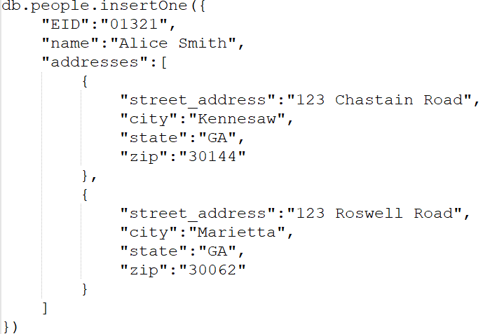
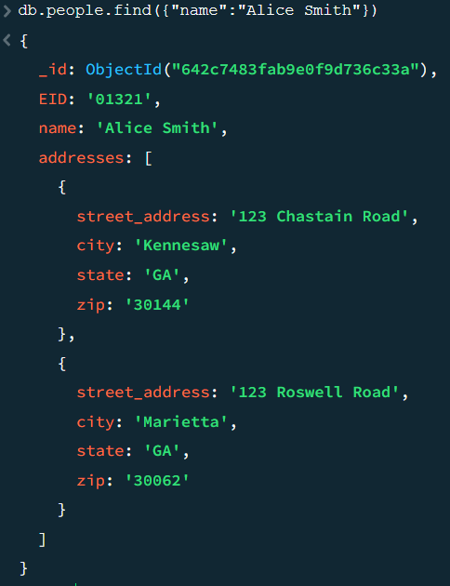
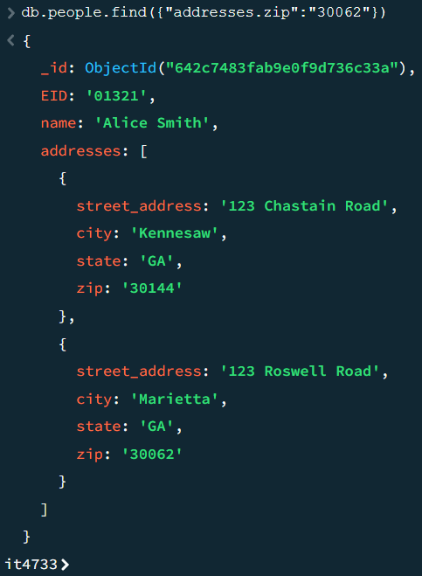
One-to-Many Relationship
One-to-many relationships can still be done with embedded documents
The field is now a list [] of embedded documents
For example, if one person has multiple addresses:
Querying with find() can be performed normally, even with embedded documents

Slide 15
List of Embedded Documents for one-to-many
db.employees.insertMany([
{"EID":"12454",
"name":"Daniel Smith",
"addresses": [
{"street_address":"123 Chastain Road",
"city":"Kennesaw",
"state":"GA",
"zip":"30144"},
{"street_address":"111 Chastain Road",
"city":"Kennesaw",
"state":"GA",
"zip":"30000"}
]
}
])

Slide 16
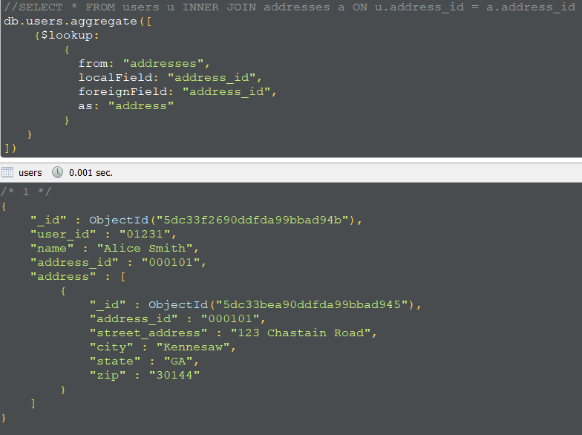
Joining in MongoDB
There are many cases where we cannot or should not use embedded documents, for example, a many-to-many relationship
We can still have multiple collections with fields referring each other to represent many-to-many relationships
And join them if needed. However, joining is limited to left outer
We use aggregate() function with the $lookup operator
db.<collection 1>.aggregate([
{$lookup: {
from: <collection 2>,
localField: <local reference key>,
foreignField: <foreign reference key>,
as: <alias of key after join>
}}
])

